Slide 1
UNDERSTANDING PLAGIARISM
By FOUZIA GOREJA
ASSISTANT PROFESSOR (NUML)

Slide 2
PERSISTENT PLAGIARISM
Many people think of plagiarism as copying another's work or borrowing someone else's original ideas. But terms like "copying" and "borrowing" can disguise the seriousness of the offense:
According to the Merriam-Webster online dictionary, to "plagiarize" means:
to steal and pass off (the ideas or words of another) as one's own
to use (another's production) without crediting the source
to commit literary theft
to present as new and original an idea or product derived from an existing source.
In other words, plagiarism is an act of fraud.

Slide 3
Cont.…
“turning in someone else's work as your own
copying words or ideas from someone else without giving credit
failing to put a quotation in quotation marks “Faith, Unity, Discipline”
giving incorrect information about the source of a quotation(original Words of author)
change words but copying the sentence structure of a source without giving credit
copying so many words or ideas from a source that it makes up most of your work, whether you give credit or not.”

Slide 4
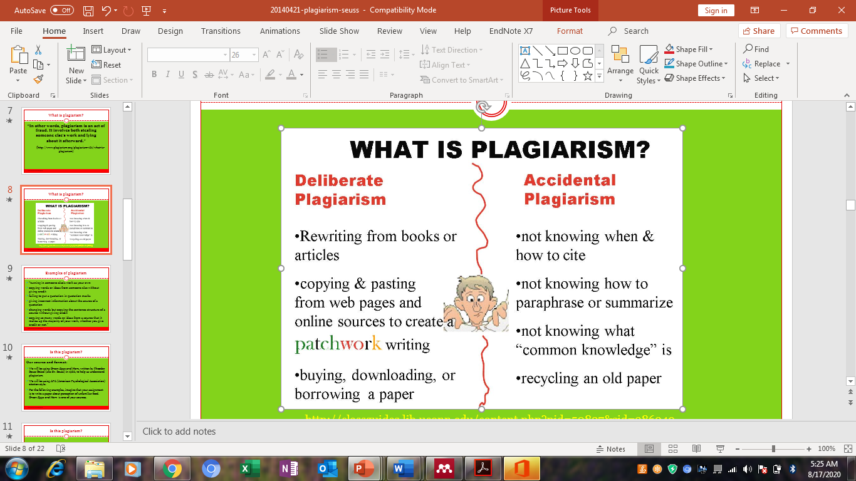
Intentional/Unintentional

Slide 5
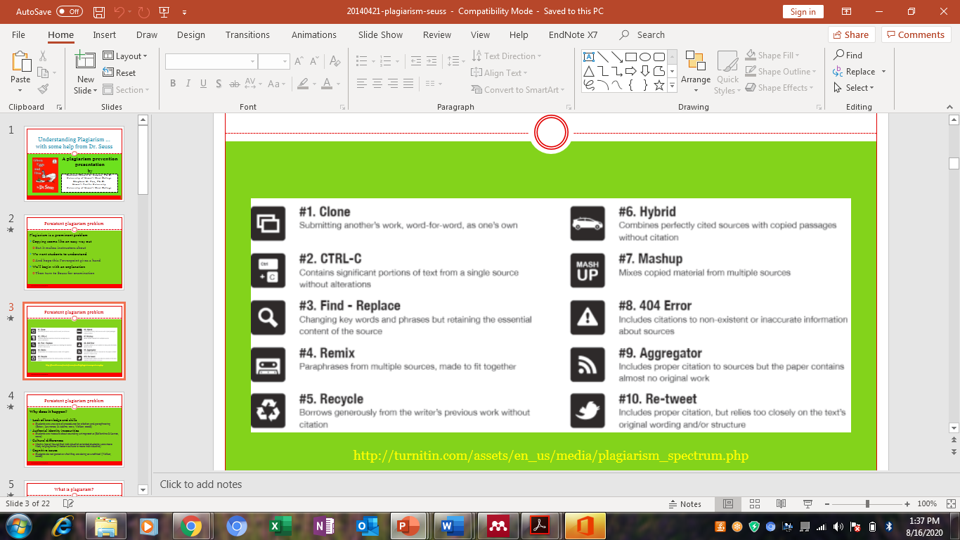

Slide 6
WHY PLAGIARIZE?
Lack of knowledge and skills
Students are unaware of procedures for citation and paraphrasing
(Estow, Lawrence, & Adams, 2011; Walker, 2008)
Authorial identity insecurities
Students are insecure about sounding unimpressive (Ballantine & Larres, 2012)
Cultural differences
Martin (2012) found that individualist-oriented students were more likely to plagiarize (Western culture is more individualist)
Cognitive(thinking pattern) issues
Students do not perceive what they are doing as unethical (Walker, 2008)

Slide 7
Read the two scenarios and select which one is considered plagiarism
1. A student makes an appointment with the family physician in order to get information about the common cold. The helpful doctor gives the student brochures about causation and treatment. The student uses quotations from the brochures and cites the source material.
2. Sara's mother has downloaded an article from the Internet on the market in Korea for computers. Sara uses the information from the article in a report for her Science class. She has lost the original article and does not remember the source. She does not cite the article in her notes.

Slide 8
Avoiding Plagiarism
Most cases of plagiarism can be avoided, however,
by citing/quoting sources. IEEE CITATION STYLE
Simply acknowledging that certain material has been borrowed and providing your audience with the information necessary to find that source is usually enough to prevent plagiarism
By paraphrasing (using your own words (synonyms) and sentence structure)
By summarizing ( picking main idea and writing briefly on the text)

